Slide 1




Modelling ammonia emissions and effect of emission reduction techniques for different animal categories
Poultry houses
Özer Bağcı
16.04.2019

Slide 2
Factors that affect ammonia emission
pH
Temperature
Moisture content of the litter
Near-floor velocity

Slide 3





How is ammonia produced and volatilized?
U∞
1. Nitrogen in the form of uric acid
Q
6. Release of gaseous ammonia from litter surface via convective mass transfer
$$J=K_{G}\left({NH}_{3(g)}−{NH}_{3(∞)}\right)$$
U(z)
z
5a. Equilibrium between dissolved ammonia and free ammonia in gas phase
$${NH}_{3}\underset{↔}{K_{h}}{NH}_{3(g)}$$
5b. Depending on pH, Conversion of dissolved ammonia into ammonium
$${NH}_{4}^{+}\underset{↔}{K_{d}}{NH}_{3}+H^{+}$$
4. Diffusion of dissolved ammonia
2. Conversion of uric acid to Urea (NH₂CONH₂)
3. Hydrolysis of Urea in the presence of ureolytic bacteria, production of dissolved ammonia
NH₂CONH₂+H₂O →CO₂+NH₃

Slide 4
pH
In every microbial step, pH plays a mediating role
Uric acid to Urea (Uricase)
Hydrolysis of uric acid to attain ammonia (Urease)
Alkaline conditions: much faster ammonification
There is a strong relation between ammonium and ammonia dependent on pH
50% of ammonia form at pH 9.3
99% is converted to ammonium (not volatile) at pH 5.5
Notes:
By alkaline: around 9 is meant
Sigurdarson, J. J., Svane, S., & Karring, H. (2018). The molecular processes of urea hydrolysis in relation to ammonia emissions from agriculture. Reviews in Environmental Science and Bio/Technology, 17(2), 241-258.

Slide 5
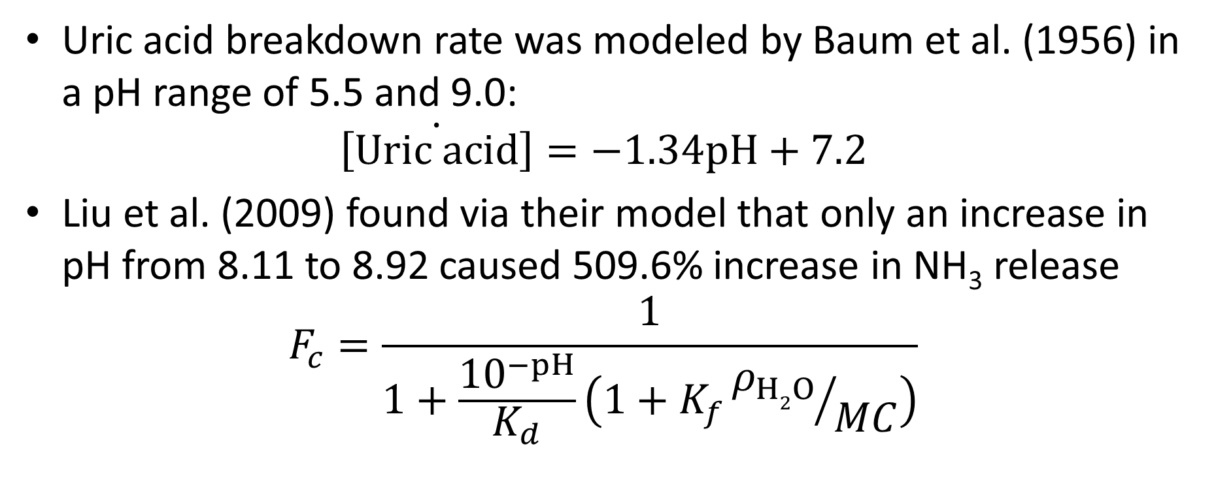
pH
Uric acid breakdown rate was modeled by Baum et al. (1956) in a pH range of 5.5 and 9.0:
$$\dot{\left[Uric acid\right]}=−1.34pH+7.2$$
Liu et al. (2009) found via their model that only an increase in pH from 8.11 to 8.92 caused 509.6% increase in NH₃ release
$$F_{c}=\frac{1}{1+\frac{{10}^{−pH}}{K_{d}}\left(1+K_{f}{ρ_{H2O}}/{MC}\right)}$$
Notes:
Liu, Z., Wang, L., Beasley, D. B., & Shah, S. B. (2009). Modeling ammonia emissions from broiler litter at laboratory scale. Transactions of the ASABE, 52(5), 1683-1694.
Fc: Freundlich partition coefficient: ratio between adsorbed and dissolved ammoniacal nitrogen
MC: moisture content of the litter
Kd0: Dissociation constant in water solution

Slide 6

pH
Even the pH itself was modeled as a function of chicken age by Elliott and Collins (1982)
$$pH=\frac{2.7{\left(0.0357×Age\right)}^{8}}{1+{\left(0.0357×Age\right)}^{8}}+5.8$$
Notes:
Elliott, H. A., & Collins, N. E. (1982). Factors affecting ammonia release in broiler houses. Transactions of the ASAE, 25(2), 413-0418.
Units of age is days, and extracted from a plot of pH versus days, where pH begins between 5 and 6.

Slide 7
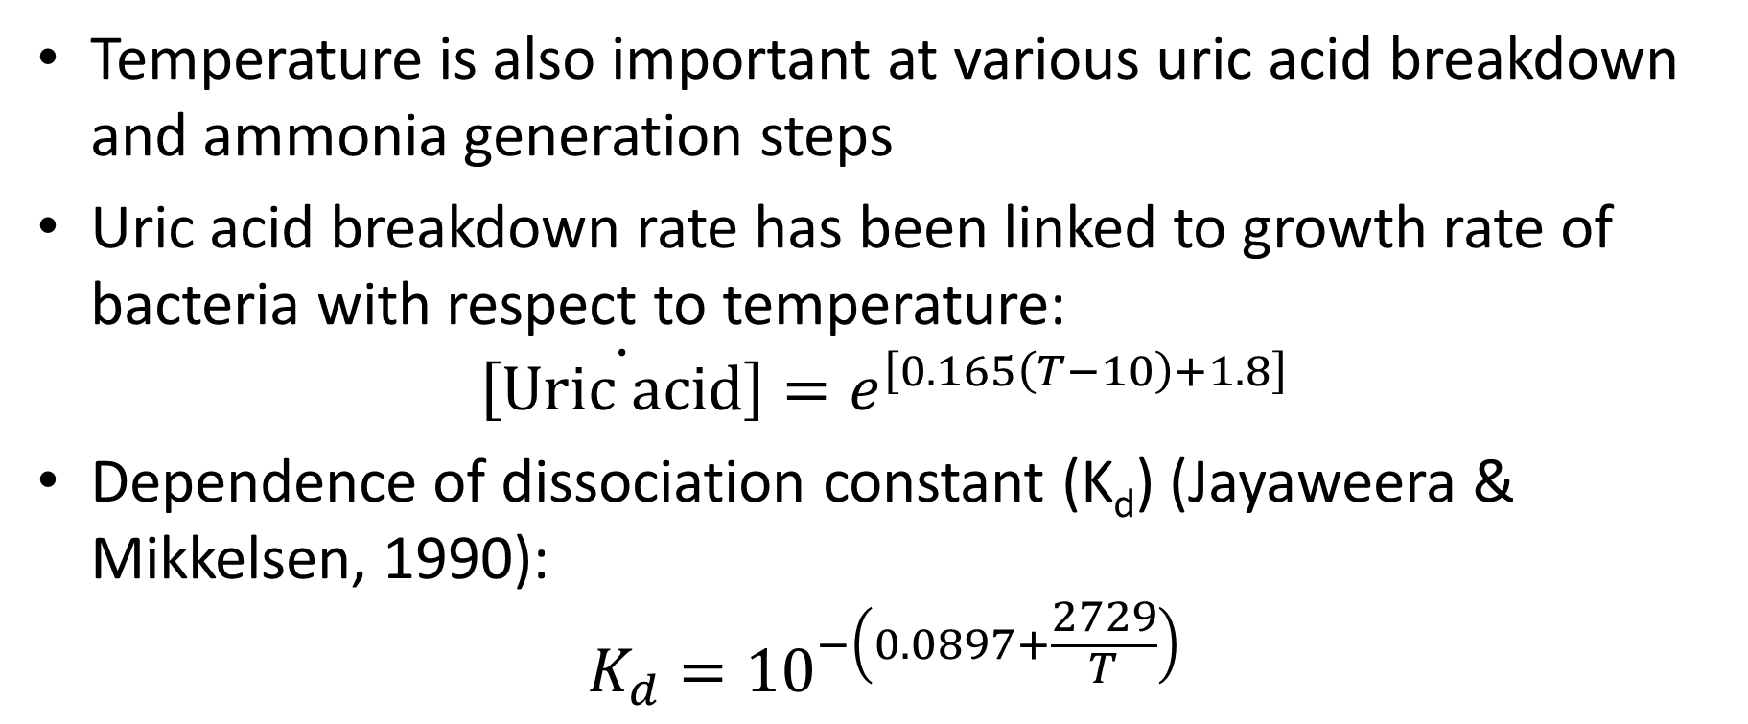
Litter temperature
Temperature is also important at various uric acid breakdown and ammonia generation steps
Uric acid breakdown rate has been linked to growth rate of bacteria with respect to temperature:
$$\dot{\left[Uric acid\right]}=e^{\left[0.165\left(T−10\right)+1.8\right]}$$
Dependence of dissociation constant (K_{d}) (Jayaweera & Mikkelsen, 1990):
$$K_{d}={10}^{−\left(0.0897+\frac{2729}{T}\right)}$$

Slide 8

Litter temperature
Litter temperature has an influence also on Henry’s law constant
$$K_{h}=\frac{4092}{T}+9.7$$

Slide 9
Moisture Content
Moisture content is very influential on ammonia generation and release:
It enhances uric acid breakdown
Enhances diffusion of dissolved ammonia in litter
Increases TAN generation rate
However it is experimentally observed that high moisture contents (35% and above) hinders ammonia release

Slide 10
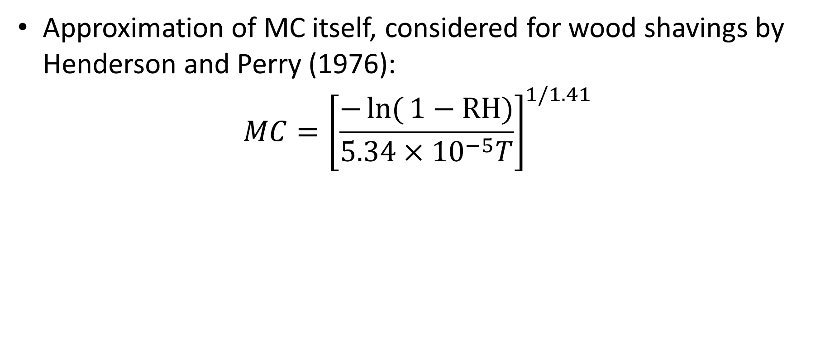
Moisture Content
Approximation of MC itself, considered for wood shavings by Henderson and Perry (1976):
$$MC={\left[\frac{−\ln{(}1−RH)}{5.34×{10}^{−5}T}\right]}^{1/1.41}$$

Slide 11
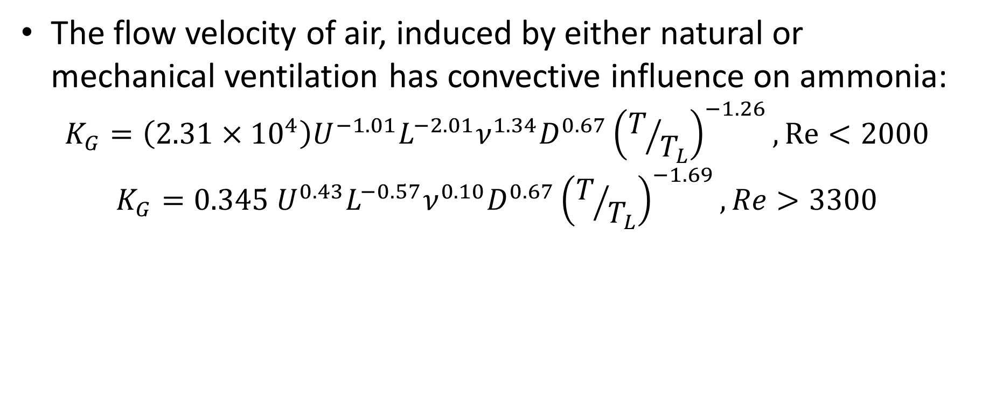
Near-floor velocity
The flow velocity of air, induced by either natural or mechanical ventilation has convective influence on ammonia:
$$K_{G}=\left(2.31×{10}^{4}\right)U^{−1.01}L^{−2.01}ν^{1.34}D^{0.67}{\left(T/{T_{L}}\right)}^{−1.26}, Re<2000$$
$$K_{G}=0.345 U^{0.43}L^{−0.57}ν^{0.10}D^{0.67}{\left(T/{T_{L}}\right)}^{−1.69}, Re>3300$$
Notes:
Liu, Z. L., Wang, L., Beasley, D. B., & Shah, S. B. (2008). Mass transfer coefficient of ammonia emissions from broiler litter. In 2008 Providence, Rhode Island, June 29–July 2, 2008(p. 1). American Society of Agricultural and Biological Engineers.

Slide 12
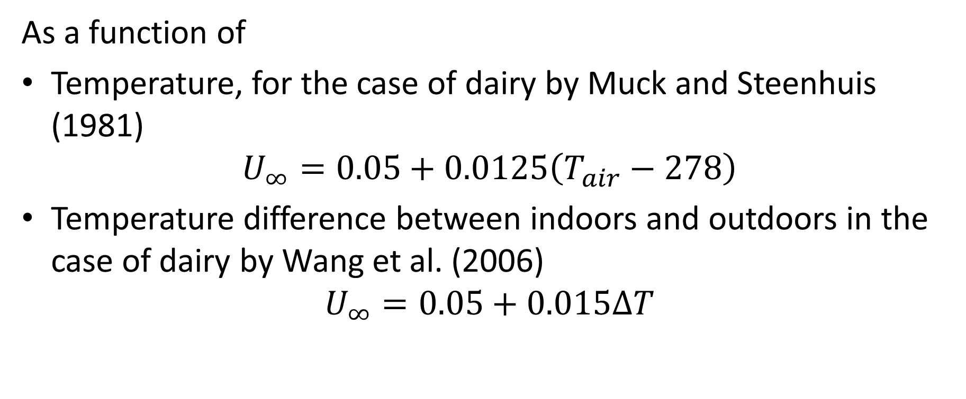
Modeling of near-floor air velocity itself
As a function of
Temperature, for the case of dairy by Muck and Steenhuis (1981)
$$U_{∞}=0.05+0.0125\left(T_{air}−278\right)$$
Temperature difference between indoors and outdoors in the case of dairy by Wang et al. (2006)
$$U_{∞}=0.05+0.015∆T$$
Notes:
Muck, R. E., & Steenhuis, T. S. (1981). Nitrogen losses in free stall dairy barns
Randall, J. M., Armsby, A. W., & Sharp, J. R. (1983). Cooling gradients across pens in a finishing piggery: II. Effects on excretory behaviour. Journal of Agricultural Engineering Research, 28(3), 247-259.
q is in cubic meters per second per square meter
Wang, C., Li, B., Zhang, G., Rom, H. B., & Strøm, J. S. (2006). Model estimation and measurement of ammonia emission from naturally ventilated dairy cattle buildings with slatted floor designs. Journal of the Air & Waste Management Association, 56(9), 1252-1259.

Slide 13
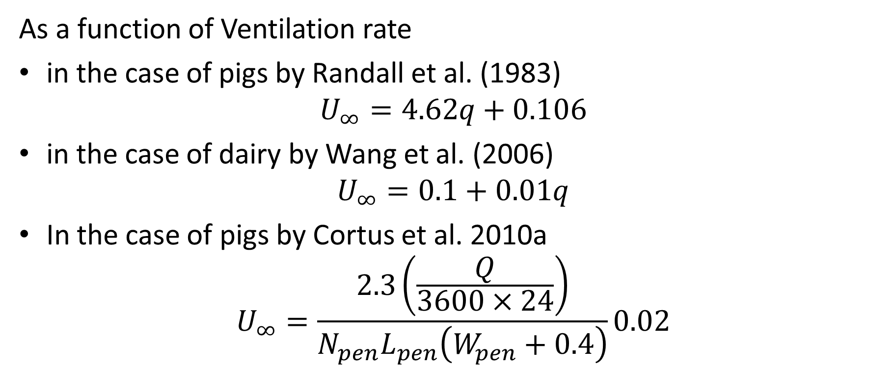
Modeling of near-floor air velocity itself
As a function of Ventilation rate
in the case of pigs by Randall et al. (1983)
$$U_{∞}=4.62q+0.106$$
in the case of dairy by Wang et al. (2006)
$$U_{∞}=0.1+0.01q$$
In the case of pigs by Cortus et al. 2010a
$$U_{∞}=\frac{2.3\left(\frac{Q}{3600×24}\right)}{N_{pen}L_{pen}\left(W_{pen}+0.4\right)}0.02$$
Notes:
Muck, R. E., & Steenhuis, T. S. (1981). Nitrogen losses in free stall dairy barns
Randall, J. M., Armsby, A. W., & Sharp, J. R. (1983). Cooling gradients across pens in a finishing piggery: II. Effects on excretory behaviour. Journal of Agricultural Engineering Research, 28(3), 247-259.
q is in cubic meters per second per square meter
Wang, C., Li, B., Zhang, G., Rom, H. B., & Strøm, J. S. (2006). Model estimation and measurement of ammonia emission from naturally ventilated dairy cattle buildings with slatted floor designs. Journal of the Air & Waste Management Association, 56(9), 1252-1259.
Cortus, E. L., Lemay, S. P., & Barber, E. M. (2010). Dynamic simulation of ammonia concentration and emission within swine barns: Part I. Model development. Transactions of the Asabe, 53(3), 911-923.
For poultry, the answer is more experiments and obtaining a velocity function of bird age/ventilation rate/temperature or a validated CFD model

Slide 14
During-round mitigation techniques
KUIKEMIS - Detection of source-oriented solutions to ammonia emissions from broiler barns
Standardized methods already being applied in the Netherlands and Belgium

Slide 15
KUIKEMIS
Influence of indoor climate (Humidity, heat and ventilation) on ammonia release
Tests will be conducted in pilot operation barns (Geel)
A computer model will be generated

Slide 16
Pilot operation test barns in Geel, Belgium
Composed of 8 compartments
Floor areas of 112.5 m² (18.9 by 6 m)
2350 animal capacity in each compartment
4 preconditioning rooms for temperature control of incoming air
Cooling by evaporative pads
Heating by heat exchangers
Heating of indoor air by delta-shaped heat exchangers
Controlling the indoor air flow patterns by a recirculation fan
Notes:
Floor areas of 112.5 m² (18.9 by 6 m)
2350 animal capacity in each compartment
4 preconditioning rooms for temperature control of incoming air
Cooling by evaporative pads
Heating by heat exchangers
Heating of indoor air by delta-shaped heat exchangers
Controlling the indoor air flow patterns by a recirculation fan

Slide 17
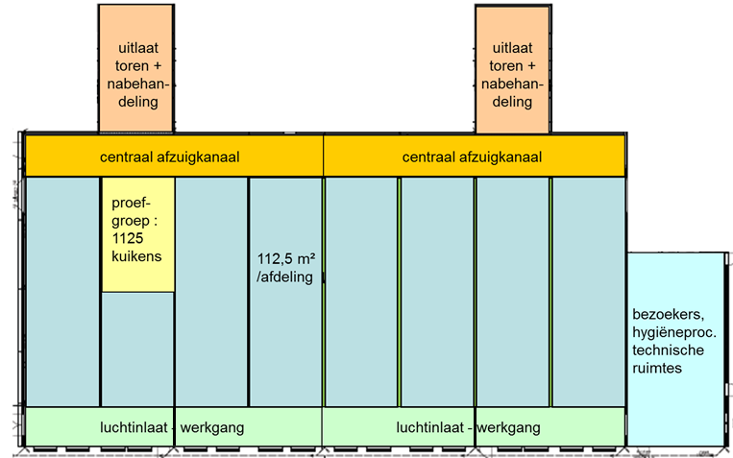
Pilot operation test barns in Geel, Belgium
Notes:
Floor areas of 112.5 m² (18.9 by 6 m)
2350 animal capacity in each compartment
4 preconditioning rooms for temperature control of incoming air
Cooling by evaporative pads
Heating by heat exchangers
Heating of indoor air by delta-shaped heat exchangers
Controlling the indoor air flow patterns by a recirculation fan

Slide 18
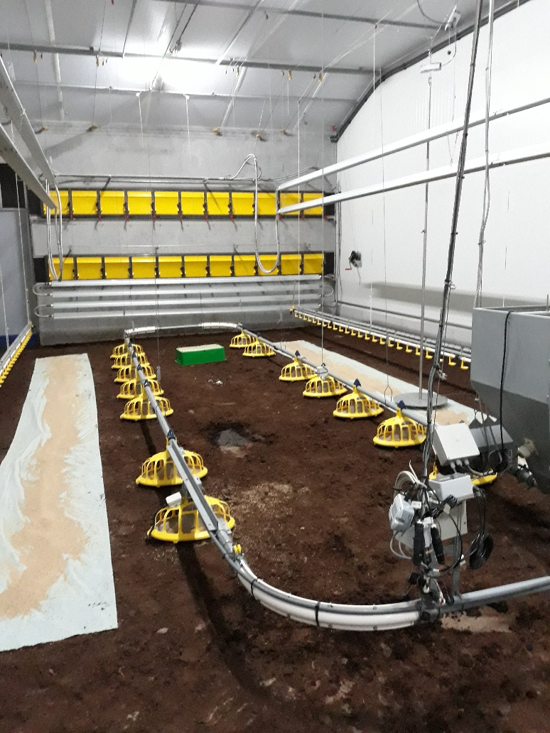
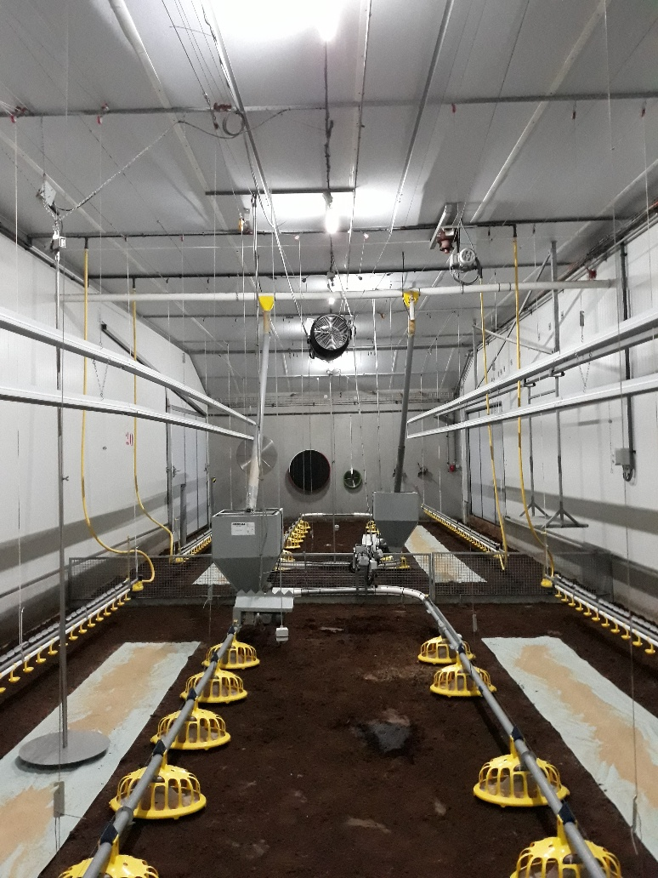
Compartments
Delta-tube heat exchangers
Inlet valves
Recirculation fan
Outlet (ATM 35, ATM 80)
Delta-tube heat exchangers
Water line
Feeding line
Notes:
Time stamps
Flow rates:
Outlet: ATM 35: 125-3500 m³/h ATM 80: 700-21000 m³/h
Recirculation fan
Indoor pressure
Controlled by the inlet valve configuration
Temperature
NH₃ (in addition: CO₂, N₂)
Humidity (Conditioning rooms, Compartments (8 points))

Slide 19
Measurement rounds
4 rounds are aimed
2 in summer, 2 in winter
During each round, 4 compartments will be used
Identical conditions in 4 compartments except those ventilation related will be studied
Local approach is preferred rather than mixed samples

Slide 20
During-round mitigation techniques
KUIKEMIS - Detection of source-oriented solutions to ammonia emissions from broiler barns
Standardized methods already being applied in the Netherlands and Belgium

Slide 21
Broiler barn regulations for ammonia release
Stable with heaters with air mixing system for drying litter

Slide 22
Broiler barn regulations for ammonia release
Stable with air mixing system for drying litter layer in combination with a heat exchanger
Notes:
A) Placing the heat exchanger outside the house and introducing air through the pipe to the ridge of the house
B) placing the heat exchanger in the house
C) introducing air from the heat exchanger with slats in the side wall and collection in the ridge

Slide 23
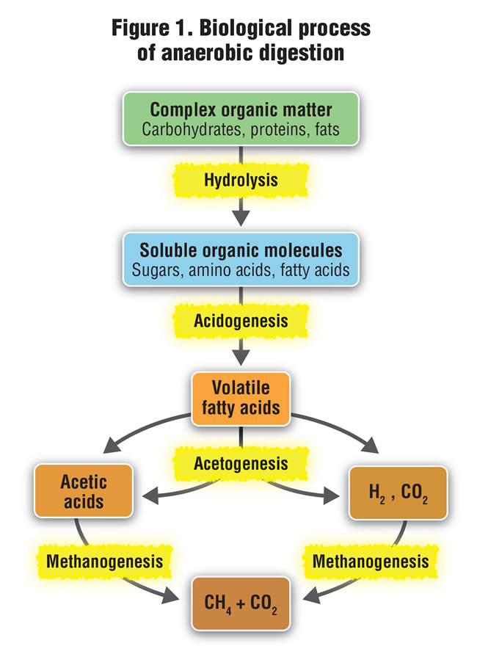
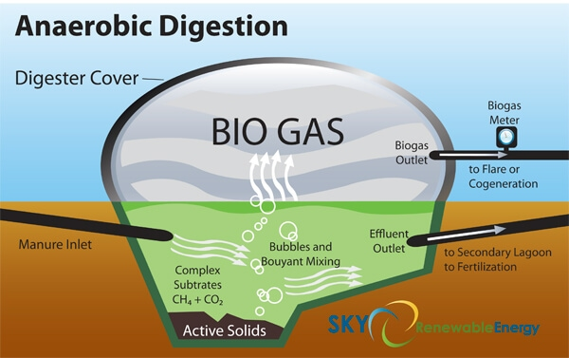
Post-round mitigation techniques
Anaerobic digestors to contain manure and produce renewable energy (after flock departures)
First AD plant was fully functional in Ballymena, Northern Ireland in 2018
Notes:
Ni, J. Q. (2015). Research and demonstration to improve air quality for the US animal feeding operations in the 21st century–A critical review. Environmental pollution, 200, 105-119.
https://www.biocycle.net/2016/11/10/managing-digester-feedstocks/
https://www.agriland.ie/farming-news/behind-the-scenes-23m-world-first-poultry-litter-ad-plant-in-ballymena/

Slide 24

Enjoy the rest of your visit in Ghent, and safe trips back home!

